Slide 1
Assignment 3
Group 6:
Chengchao Fang
Chentao Han
Kai Wang
Yiran Jin

Slide 2
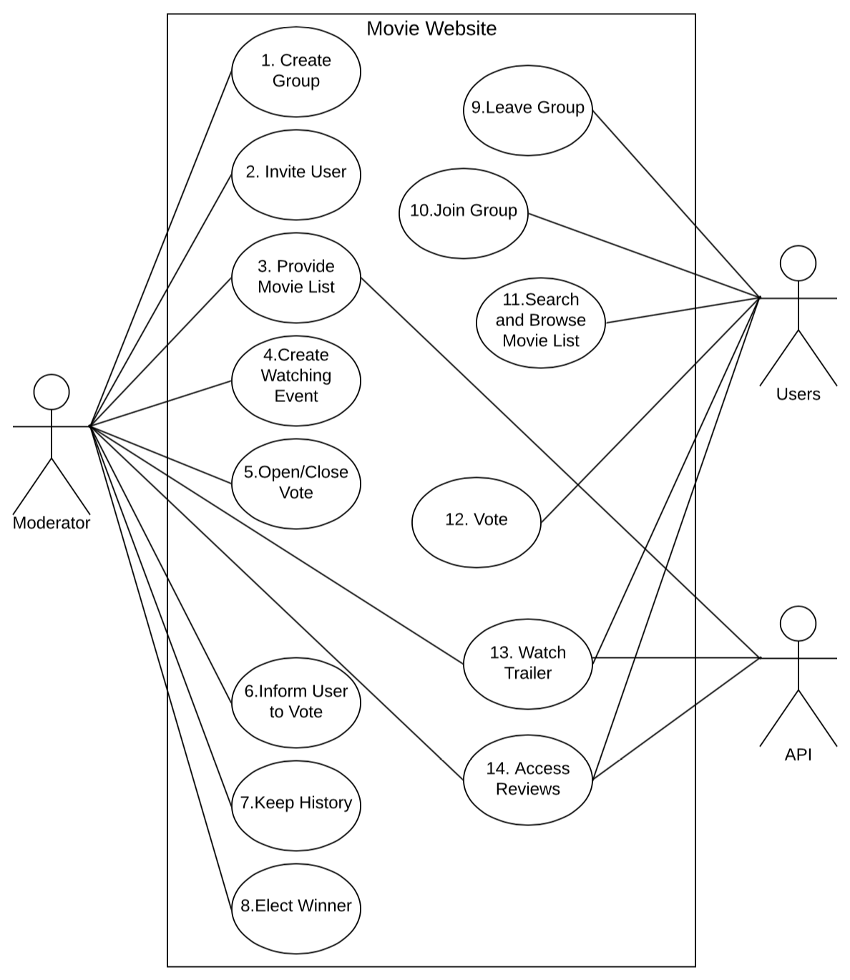
1. Use Case Diagram

Slide 3
2. Use Case Specification
1. Create Group: When moderator wants to launch an event. Moderator can create a group through click the button named “Create Group”. If the system return success, create successfully, else the system return fail, create fail.
2. Invite User: Moderator can click button named “Invite Users” when they want to invite some people to the group, then input the ID of who he/she want to invite in. If the system return success, invitation submit successfully, else return fail.
3. Provide Movie List: After moderator create a group, he/she need to get a movie list from API, he/she click the “Get Movie List” button, then the system return success, import the movies’ names resources successfully, else return fail.
4. Create Watching Event: After moderator create groups, he/she need to choose the time and situation he/she want to organize this event. Through click the button named “Create Event” and then input the information of event. System return success, create successfully, else return fail.
5. Open/Close Vote: Once the moderator finish creating movie list, he/she can open vote immediately, then some days later, he/she can close vote. When he/she click button names “Open/Close Vote”, system return success, open/close successfully, else return fail.

Slide 4
2. Use Case Specification
6. Inform User To Vote: When moderator open the vote function, he/she can choose to inform users to do a vote, he/she click button named “Inform User”, system return success, inform successfully, and the system will send message to users, else return fail.
7. Keep History: When vote finish, moderator can choose to save the information about this event and vote data through clicking button named “Keep History”, system return success, save successfully, else return fail.
8. Elect winner: After moderator close the vote, he/she need to choose a winner movie, so he/she can click the button named “Elect Winner”, the system return the winner name if run successfully, else return fail.
9. Leave Group: Users can leave the group when they do not or cannot join the group event. User just need to click the button named “Leave Group”, system return success, user leave the group successfully, else return fail;
10. Join Group: When user receive an invitation from moderator, he/she can choose whether join this group, if they want to join this group, click the button named “Accept”, system return success, user join group successfully, else return fail. If user do not want to join this group, he/she click button “Refuse”.

Slide 5
2. Use Case Specification
11. Search and Bowser Movie List: After moderator provide movie list, users in this group can search and browser movie list through click “Movie List” button, the web page will jump to the movie list page, and users can search some key words to search.
12. Vote: After moderator open the vote function, user can vote his/her favorite movies by choose the movie and then click button “Submit”, system return success, submit successfully, else return fail.
13. Watch trailer: When user search and bowser the movie list, they can watch trailer which movie they want to know get more information such as watch trailer. He/She can just click the movie they the web will jump to the target page.
14. Access reviews: When user search and bowser the movie list, they can watch trailer which movie they want to know get more information such as read reviews. He/She can just click the movie they the web will jump to the target page.

Slide 6
2. Bi-direction traceability matrix
Requirement Traceability Matrix (RTM) is a table (mostly a spreadsheet) that shows if each requirement has a respective Test case/cases to make sure if the requirement is covered for testing.It is basically used to ensure that ALL the requirements and Change Requests are or will be tested.
Our traceability matrix table includes Test Case ID Description table and overall table.

Slide 7
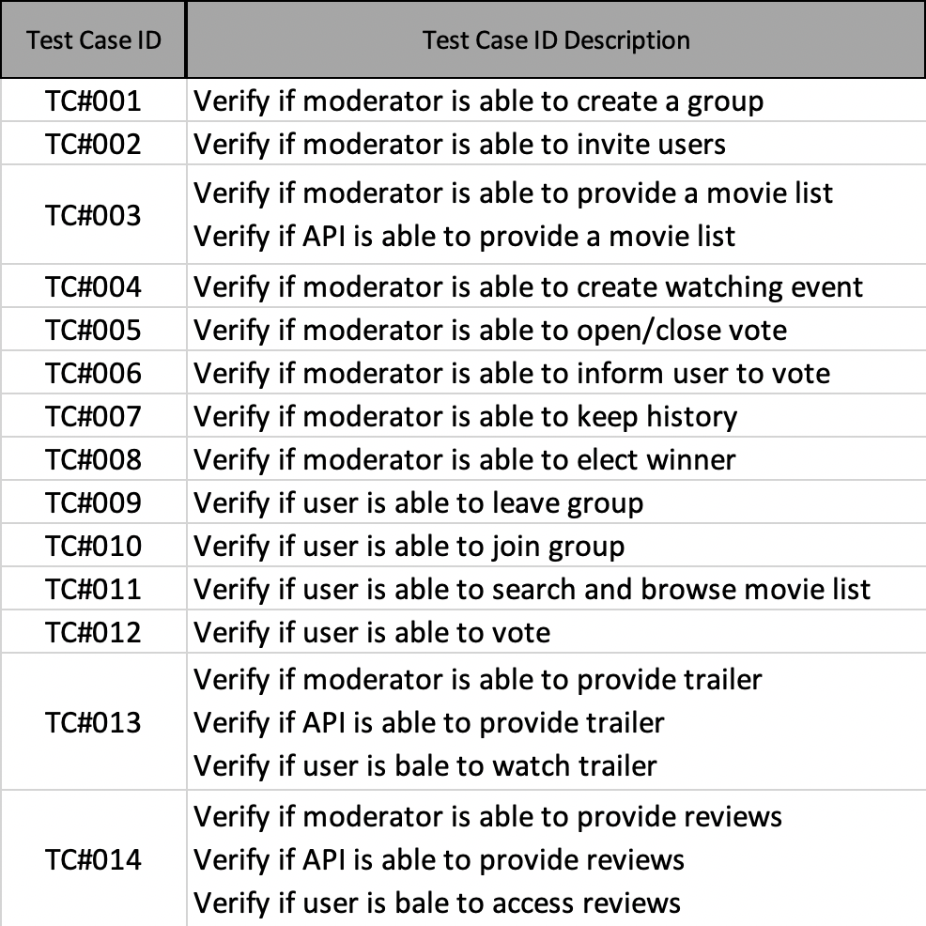
Test Case ID Description table

Slide 8
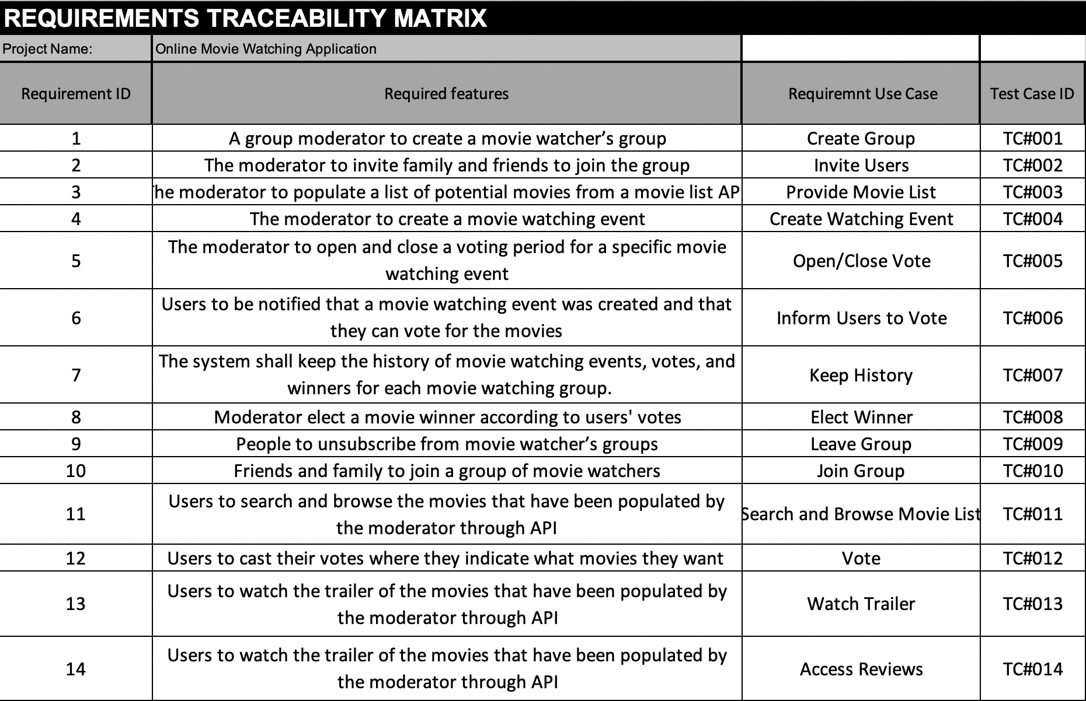
Overall table

Slide 9
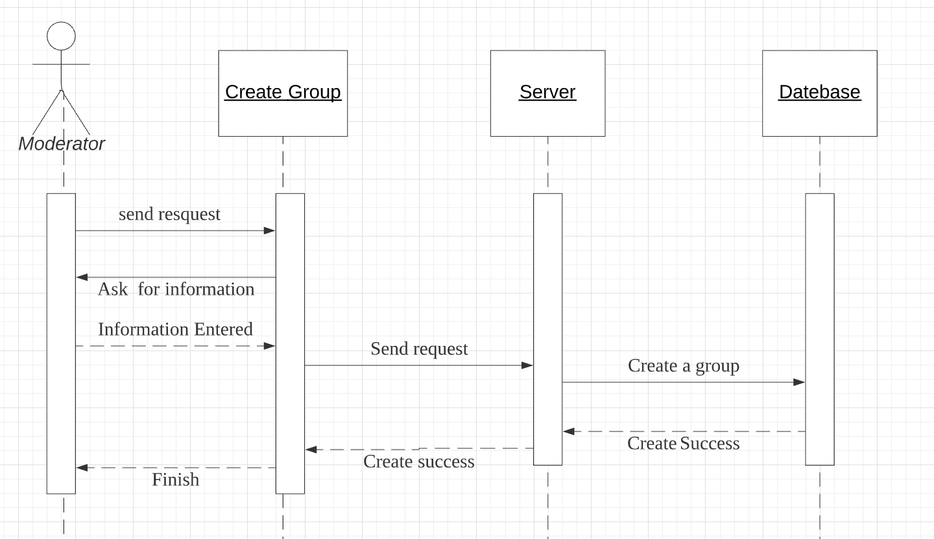
4.Sequence Diagram for Each Use Case
Create Group

Slide 10
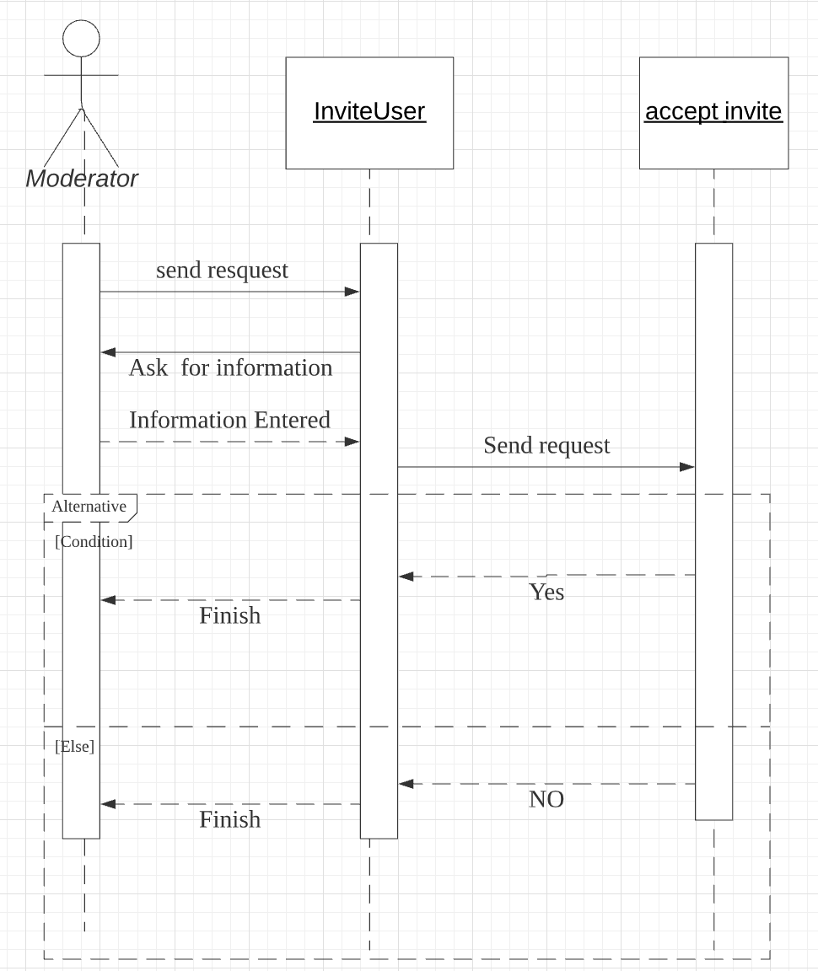
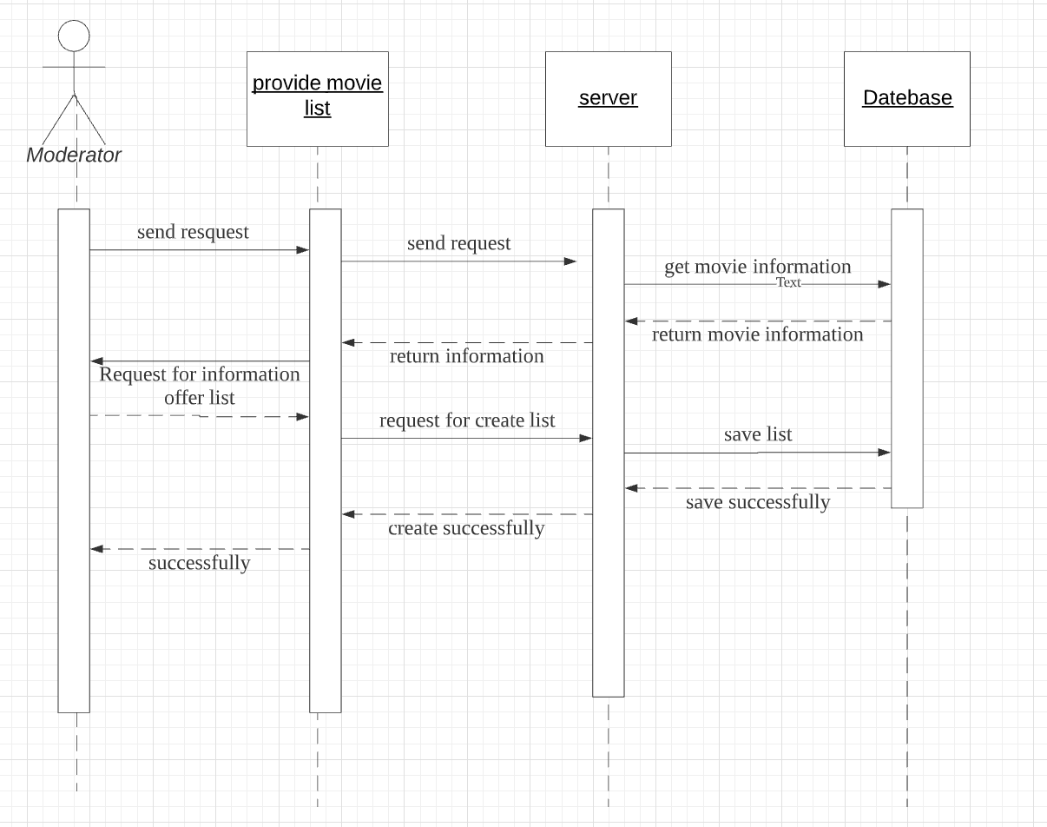
Sequence Diagram
Invite
users
Provide move list

Slide 11
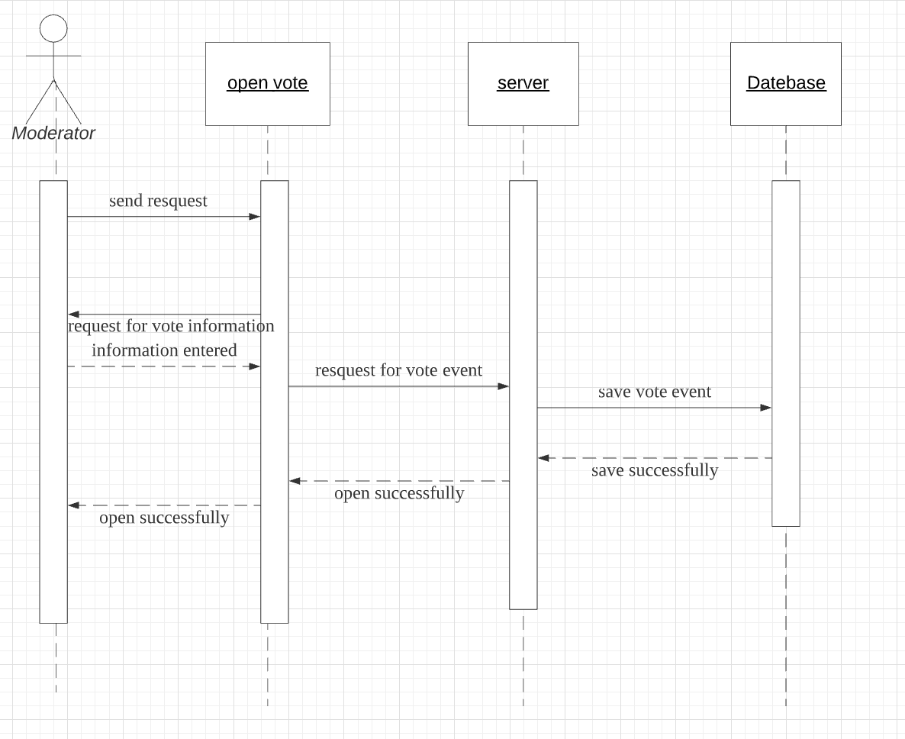
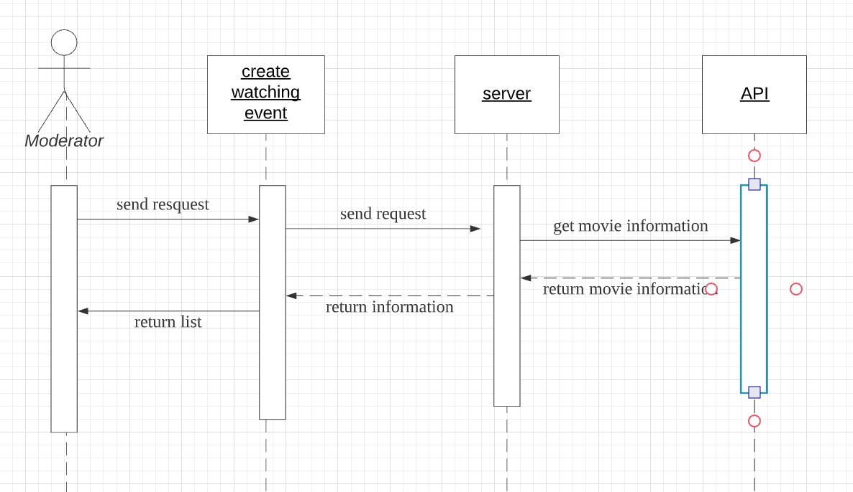
Sequence Diagram
Create watching event
Open vote event

Slide 12
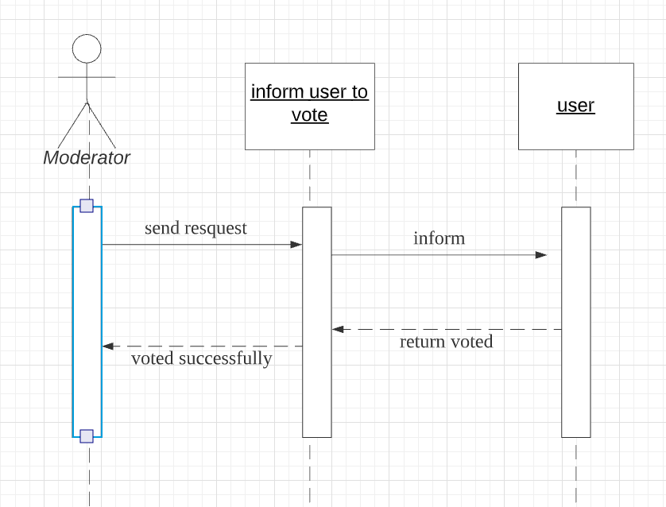
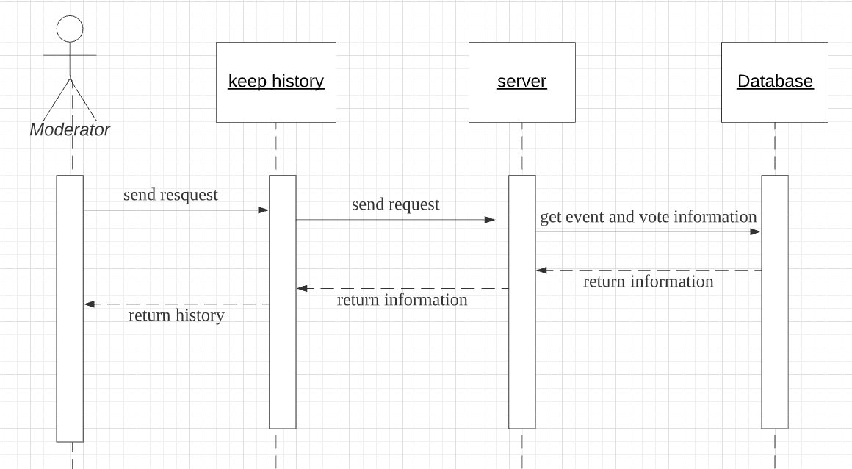
Sequence Diagram
Keep history
Inform user to vote

Slide 13
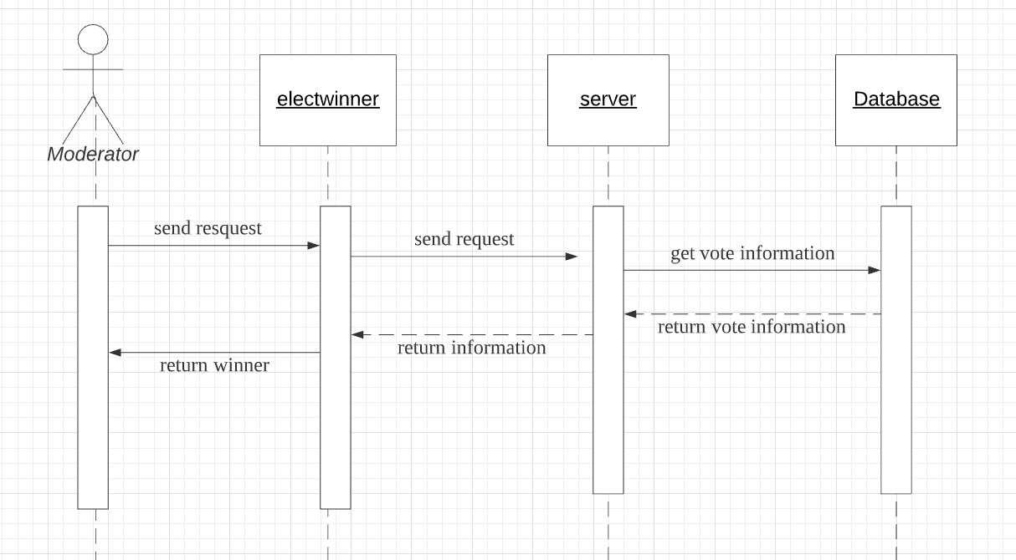
Sequence Diagram
Elect winner

Slide 14
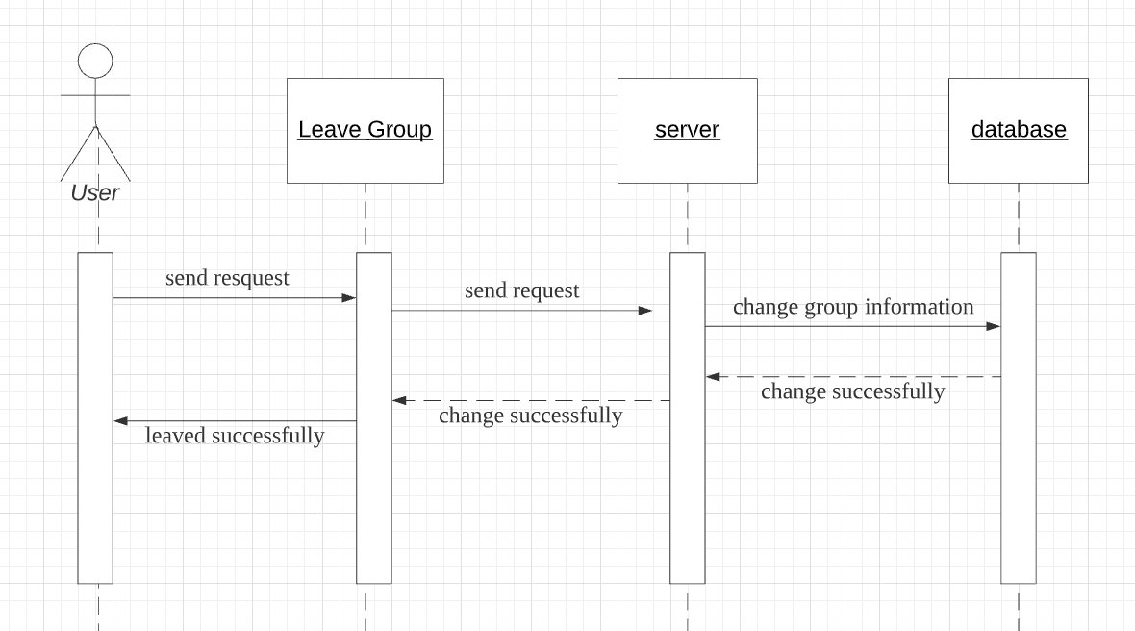
Sequence Diagram
Leave a group

Slide 15
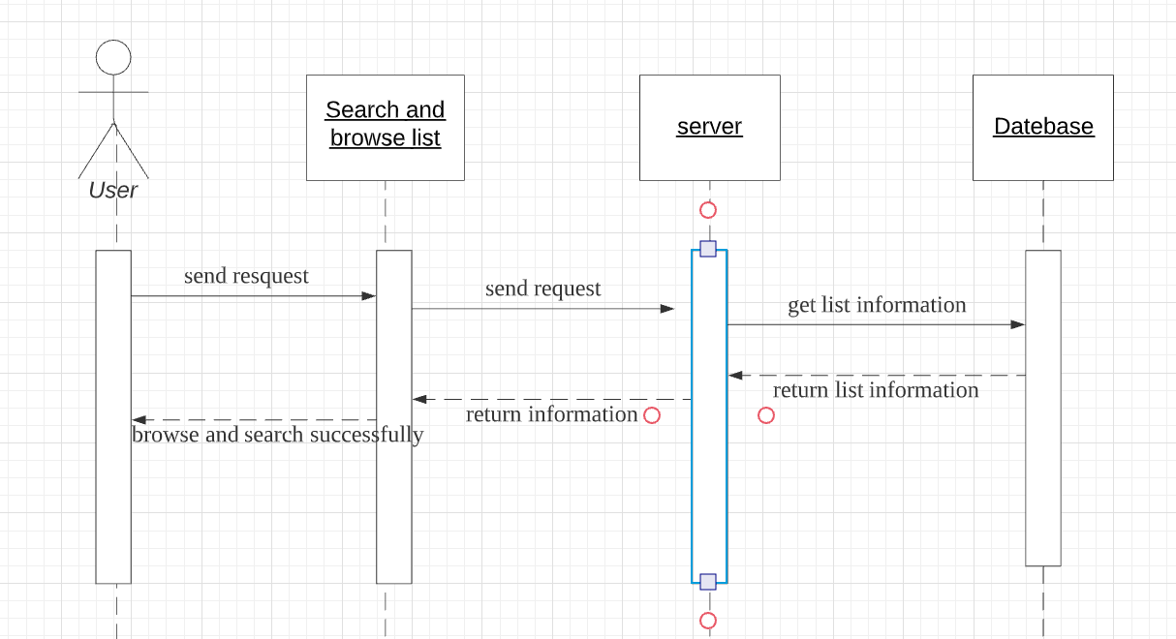
Sequence Diagram
Search and browse list

Slide 16
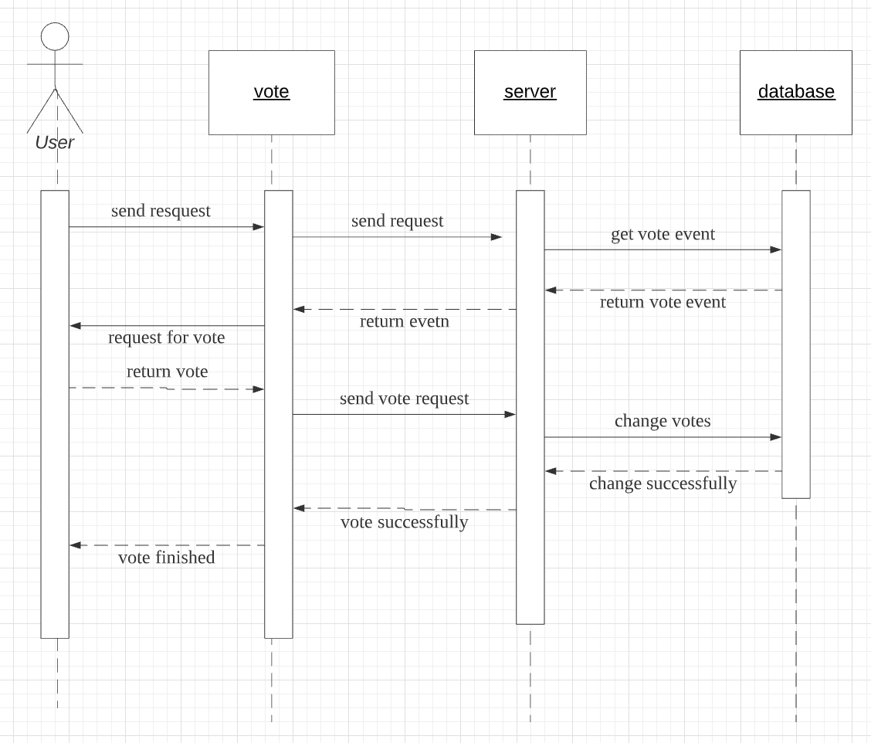
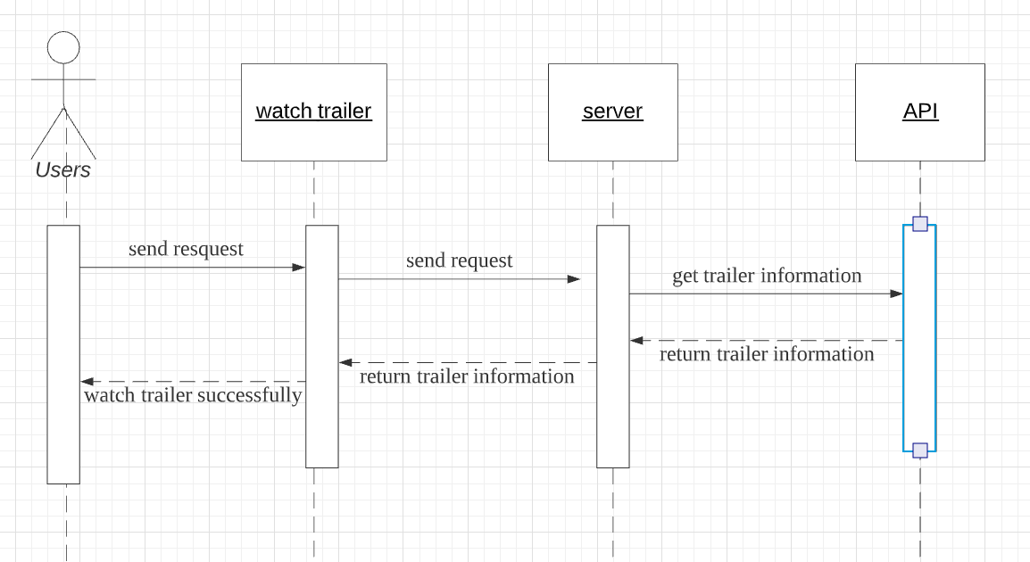
Sequence Diagram
Watch trailer
vote

Slide 17
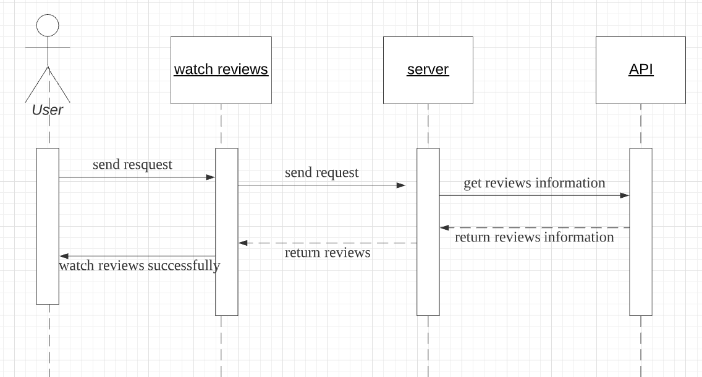
Sequence Diagram
Watch reviews

Slide 18
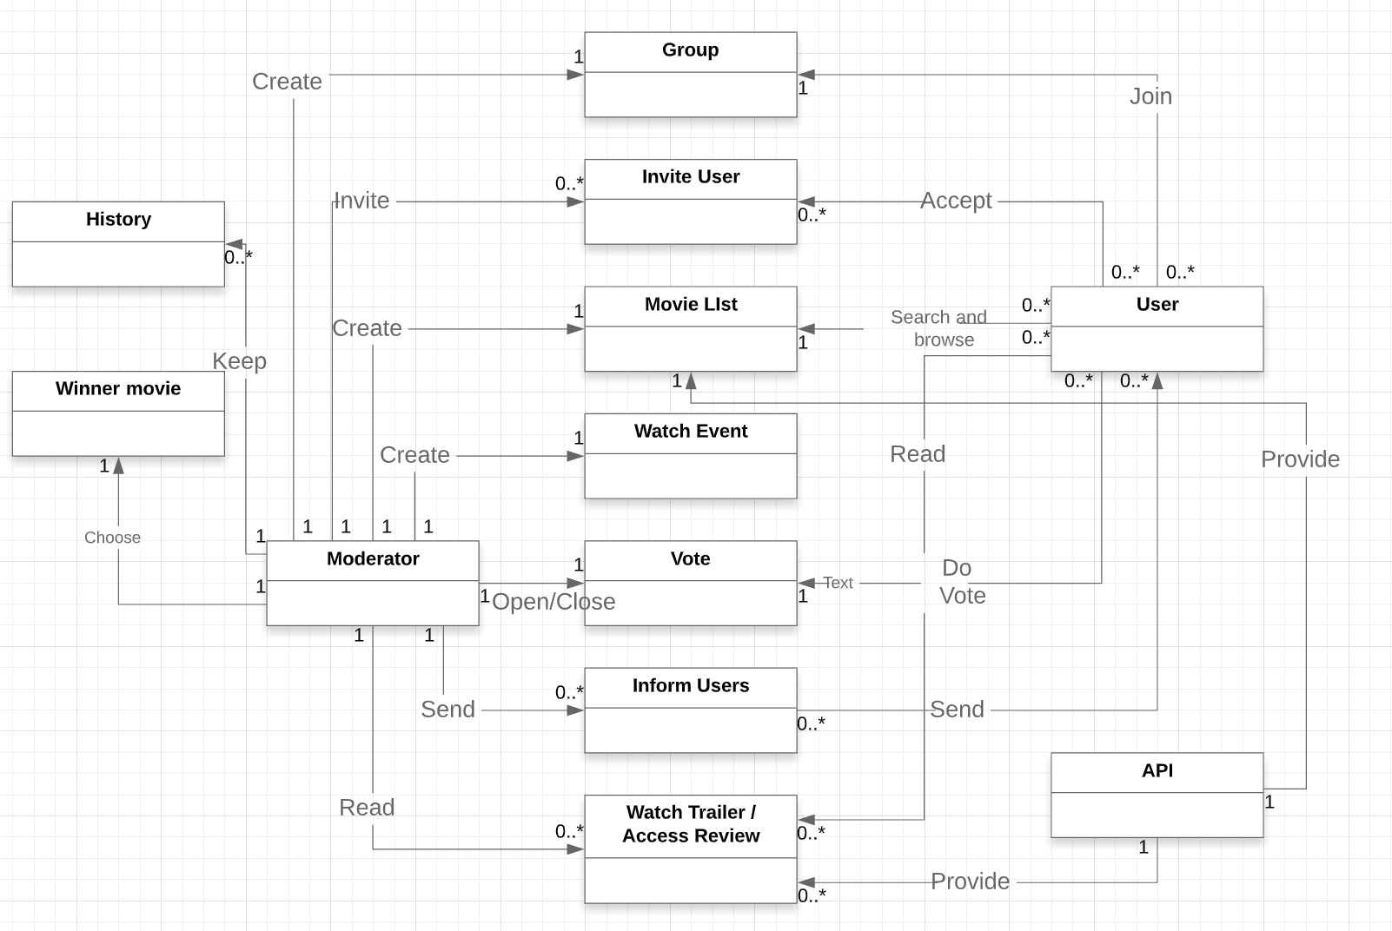
5. Class
Diagram
Modle

Slide 19
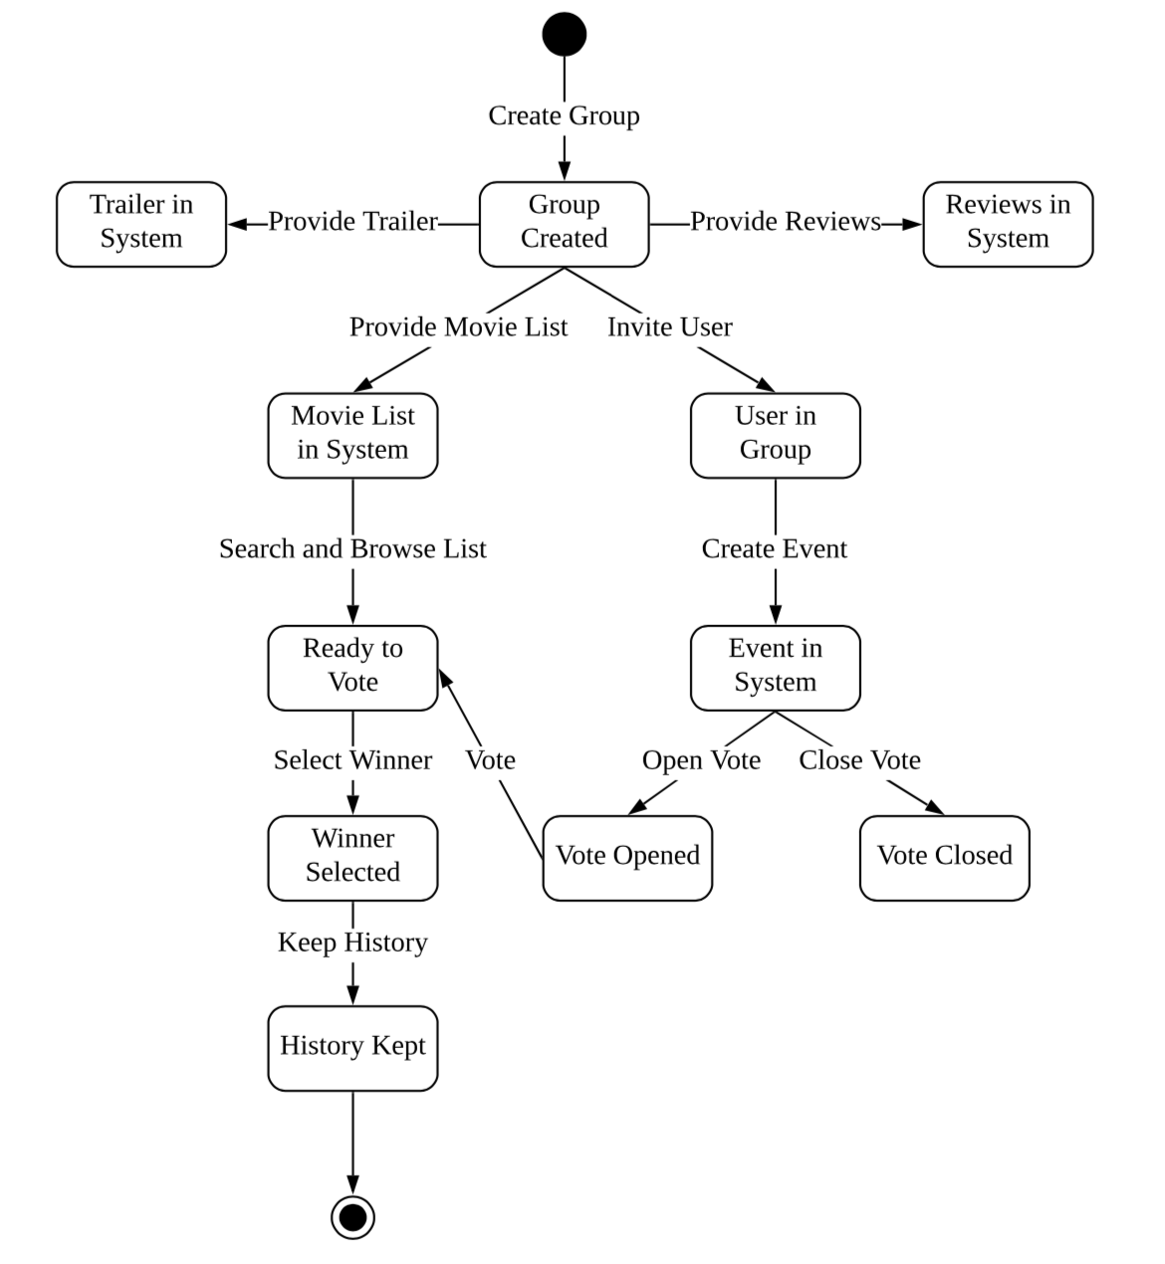
6. State Diagram

